Slide 1
Simple Circuits Worksheet 5B
(Generic brake and turn signals)
By James McElroy

Slide 2
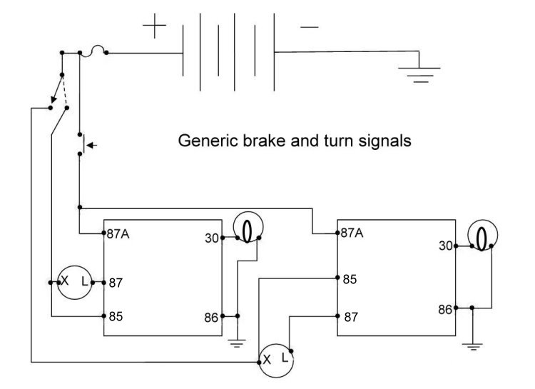
Simple Circuits Worksheet 5B
(Generic brake and turn signals)

